Slide 1
Using the UK Generations and Gender Survey & Harmonised Histories for event history analysis
Dr. Bernice Kuang
Full resource, see: https://www.ncrm.ac.uk/resources/online/all/?id=20861

Slide 2
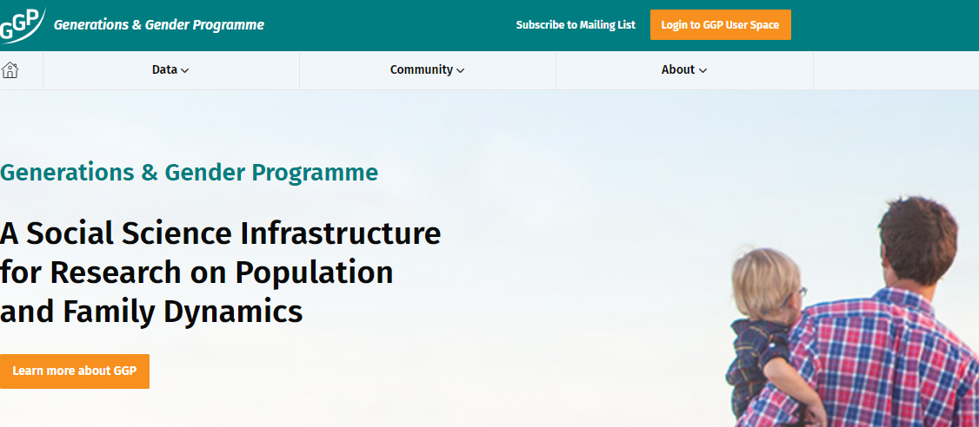
The Generations and Gender Programme
GGS Round 1: 2004-2011,
Wave 1: 19 countries; Wave 2: 14; Wave 3: 3
Harmonised Histories
GGS Round 2 Wave 1: 2020+,
Currently available:
Austria, Belarus, Denmark, Estonia, Kazakhstan, Moldova, Norway, Sweden, the UK, Czech Republic, Finland, France, Germany, Croatia, Argentina, Hong Kong, Uruguay, Taiwan
GGS Round 2 Wave 2: Moldova, Norway
https://www.ggp-i.org/

Slide 3

What partnership data is in the GGS?
Union histories
Number of co-residential intimate relationships, including any current relationships
The only living apart together relationship (LAT) counted is the current relationship
For each co-residential relationship, including current
Number (first, second etc.)
Union start year and month (when they first moved in together)
Marriage + year and month
Separation + year and month
Divorce + year and month
Number of children (bio, step, adopted)

Slide 4

What birth information is in the GGS?
Birth/Fertility histories
Per child
Number (first, second etc.)
Birth year and month
Sex
Still living?
Still lives with parents?
Activity status (i.e. education, employment)
Subjective health

Slide 5
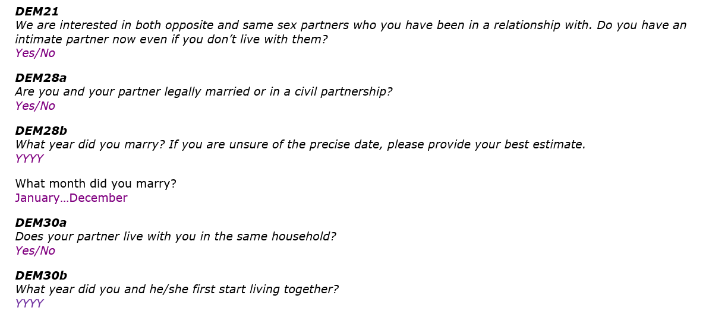

How is that data collected in the questionnaire?
Starts with CURRENT STATUS & number of children with CURRENT partner

Slide 6
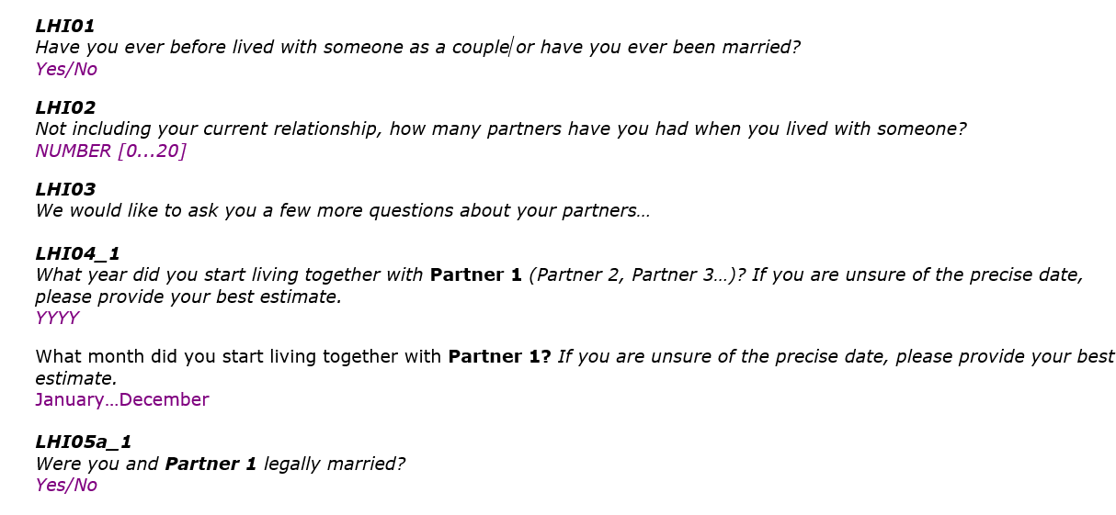

Then, asks about previous partners, and number of children with previous partners, starting from the 1st partnership and moving forward in time

Slide 7
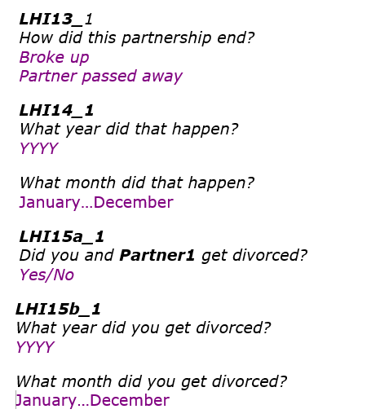

Including how previous partnerships ended….

Slide 8
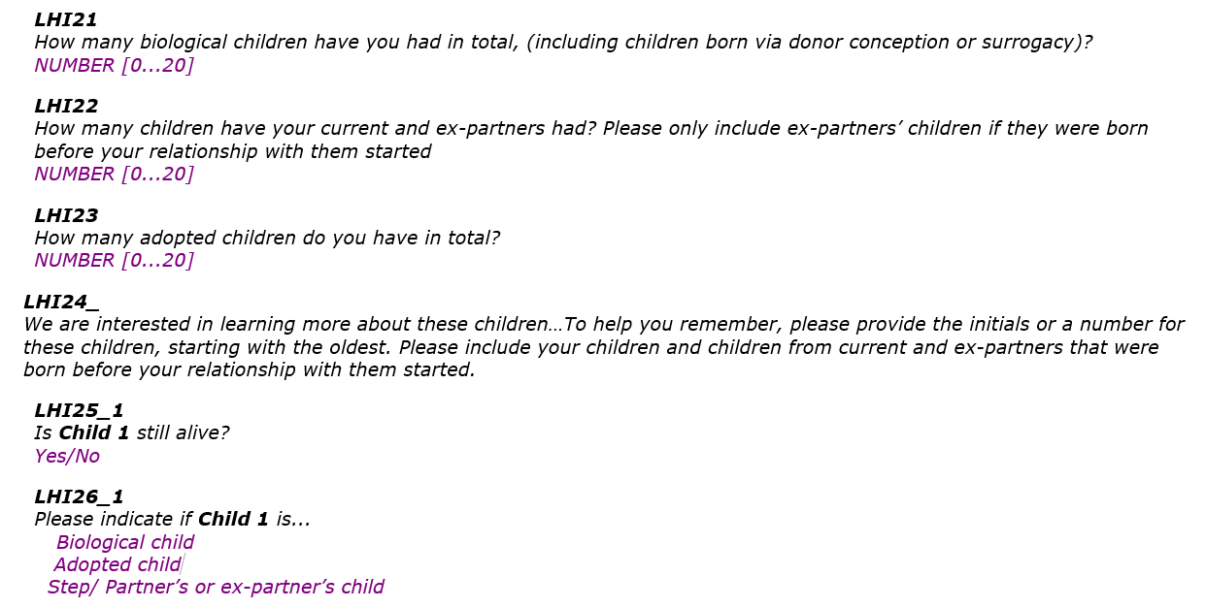
After that, detailed fertility histories are collected, child by child

Slide 9
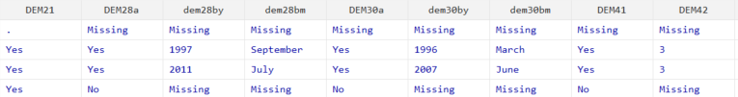
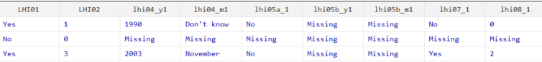
How does it look?
Current partner
Married? If so, from when?
Cohabiting? If so, from when?
Any kids together?
Previous partner?
P1- When cohabit?
Married to P1?
Any kids with P1?
Notes:
After all that, what does the data look like. Well. At first glance, it’s kind of hard to read. But here it is. The rows are individual respondents, the top part are variables about the CURRENT partner, the bottom part is about PARTNER NUMBER 1
Dem21 Do you have a partner Dem28 Are you married to the partner if you are, when Dem30 Are you living with the partner If you are, when did you start living together
Dem41 Do you have bio children with partner If yes, how many
LHI01 Ever lived w partner LHI02 If yes, how many LHI04 year moved in – BECAUSE RELATIONSHIP DOESN’T COUNT IF YOU’RE NOT COHABITING LHI05 married to partner? Yes no if yes when
LHI07 Have kids with partner? Yes no LHI08 if yes how many

Slide 10
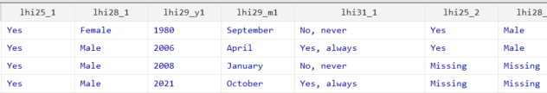
How does it look?
Fertility Histories
Child 1 alive?
Child 1 sex?
Child 1 DOB?
Child 1 live with you?
Child 2…

Slide 11
Harmonised Histories

Slide 12
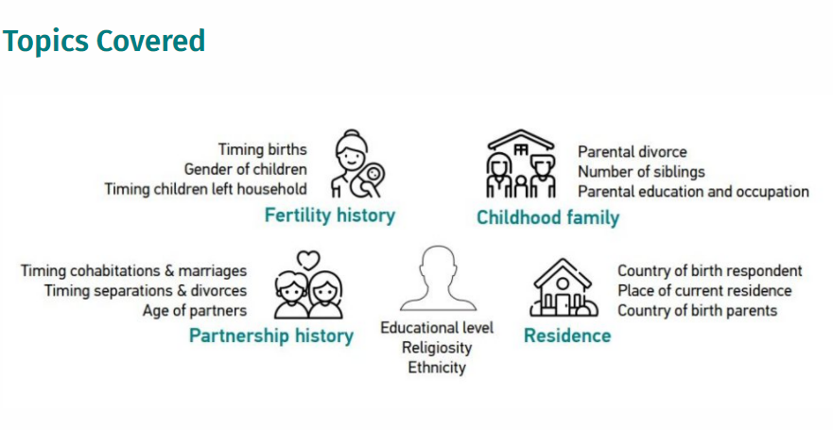
What are the Harmonised Histories?

Slide 13


How does it look? Nice and tidy ☺
Partnership Histories – perfect for event history analysis
Union of order 1?
Separation of union 1?
Marriage of union 1?
Divorce of union 1?

Slide 14

How does it look?
Fertility Histories – perfect for event history analysis
Is there a first order kid?
What is sex of first kid?
Year first kid left home?

Slide 15
Where to download? - https://www.ggp-i.org/
Download here:
Harmonised Histories Round 1
Austria, Belgium, Germany, Czechia, Estonia, France, Norway, Romania, Poland, Netherlands, Hungary, …. Other countries based on non-GGS datasets (i.e. Family & Fertility Survey, PAIRFAM, British Household Panel Study, National Survey Family Growth)
Harmonised Histories Round 2
Czechia, Denmark, Estonia, Norway, Italy (not derived from GGS)

Slide 16
www.ncrm.ac.uk

